Slide 1
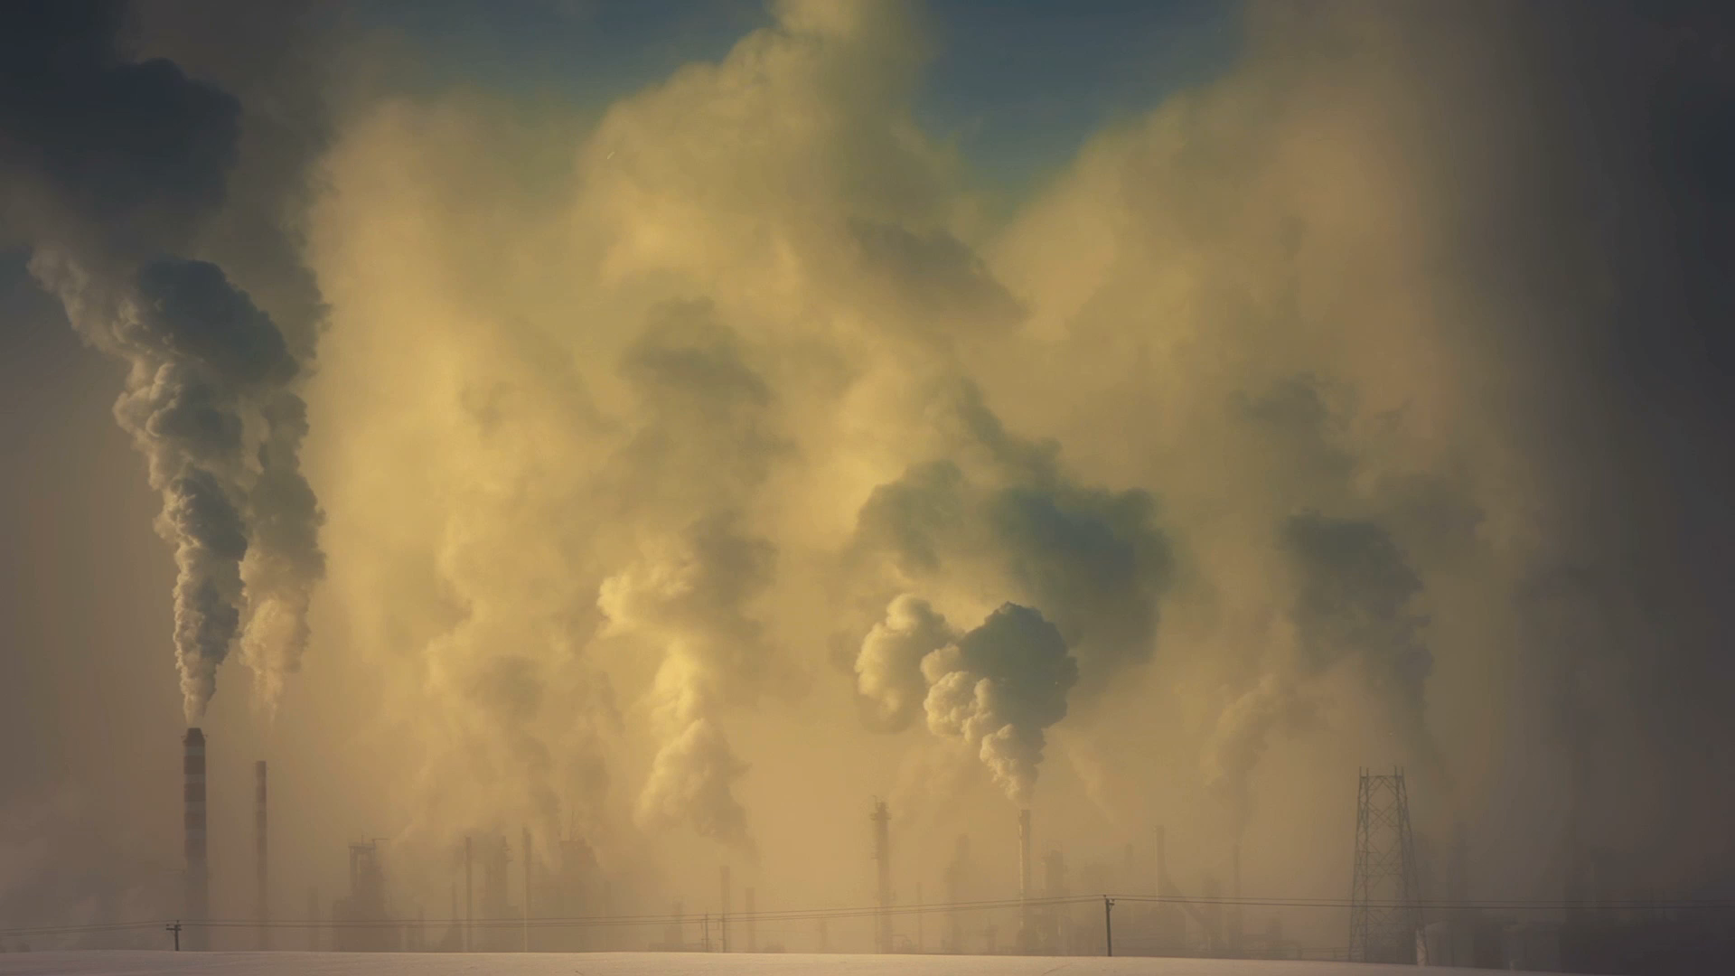
CO2 Emission Trends

Slide 2
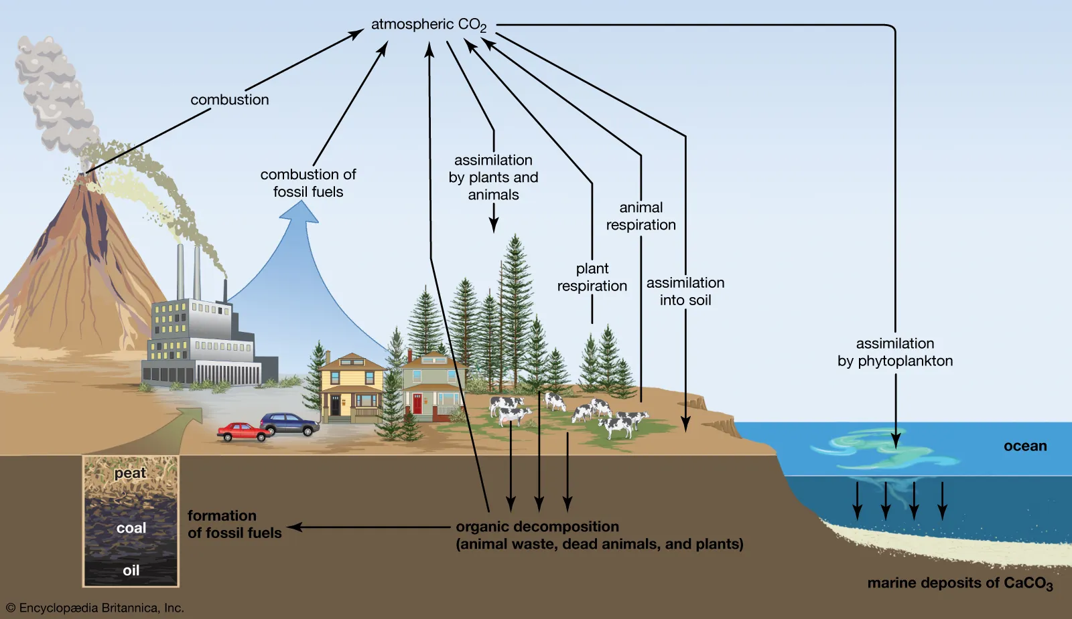
What is Climate Change?
Climate change refers to long-term shifts in temperatures and weather patterns.
Climate changes may be natural, such as through variations in the solar cycle. Since the 1800s, human activities have been the main driver of climate change, primarily due to burning fossil fuels such as coal, oil and gas.
Burning fossil fuels generates greenhouse gas emissions that act like a blanket wrapped around the Earth, trapping the sun’s heat and raising temperatures.
Examples of greenhouse gas emissions that are causing climate change include carbon dioxide and methane.
Energy, industry, transport, buildings, agriculture and land use are among the main contributors to greenhouse gas emissions.

Slide 3
The Paris Agreement
The Paris Agreement is a legally binding international treaty on climate change. It was adopted by 196 Parties at the 21st Conference of the Parties in Paris, on 12 December 2015 and entered into force on 4 November 2016.
Its goal is to limit global warming to well below 2, preferably to 1.5 degrees Celsius, compared to pre-industrial levels.
To achieve this long-term temperature goal, countries aim to reach global peaking of greenhouse gas emissions as soon as possible to achieve a climate neutral world by mid-century.
The Paris Agreement is a landmark in the multilateral climate change process because, for the first time, a binding agreement brings all nations into a common cause to undertake ambitious efforts to combat climate change and adapt to its effects.

Slide 4
Dataset Selection and Exploration
The main goal of the project was to predict if the Paris Agreement would be achieved by analyzing the trends of CO2 emissions.
The dataset was obtained from Kaggle and was provided by CICERO Center for International Climate Research.
The dataset contained total CO2 Emissions (MtCO2) from coal, oil, gas, cement, flaring, other sources, and per capita with > 60,000 rows of data collected from 1750 to 2022.
To begin analysis of the dataset, it was imported into a PostgresSQL database in PgAdmin4 using Amazon Web Services (RDS, S3, EC2), Google Colab, and PySpark.

Slide 6
Goals
Goals:
The Paris Accord states that the goal for CO2 emissions should be at least a 40% reduction by 2030 compared to 1990 CO2 levels (approx. 22 millions MtCO2). Goal is to analyze to see if this is achievable.
Statistical Analysis to find the countries that contributed the most to global CO2 emissions.

Slide 7
Data Cleaning
The dataset provided was cleaned and it was ready to be used for analysis. However, some cleaning was still done to properly used the data such as:
All rows except “global” were removed to analyze the global trend of CO2 and to come out with predictions.
All rows except 2021 year was shown to analyze the 2021 biggest polluters.
All rows except 2000 year was shown to analyze the 2020 biggest polluters.
All rows except 1980 year was shown to analyze the 1980 biggest polluters.

Slide 8
Analysis
Linear Regression
Unsupervised Machine Learning
Deep Neural Network

Slide 9
Linear Regression
Linear Regressions were made for 4 different timeframes
1750-2021
1900-2021
2000-2021
1980-2021

Slide 10
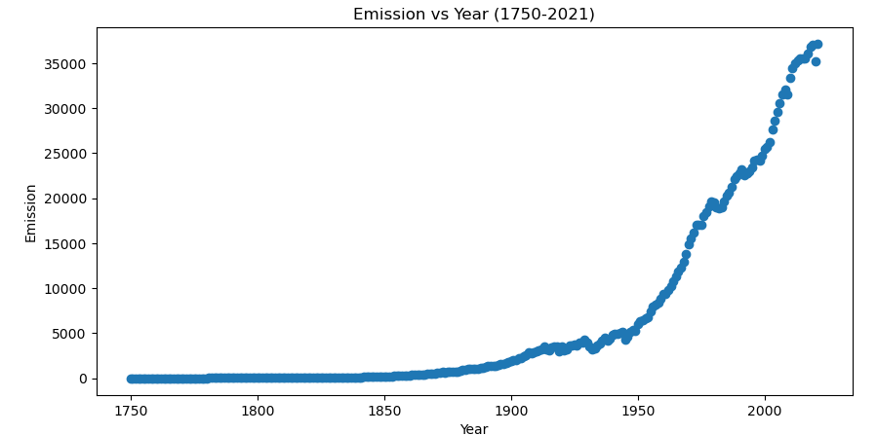
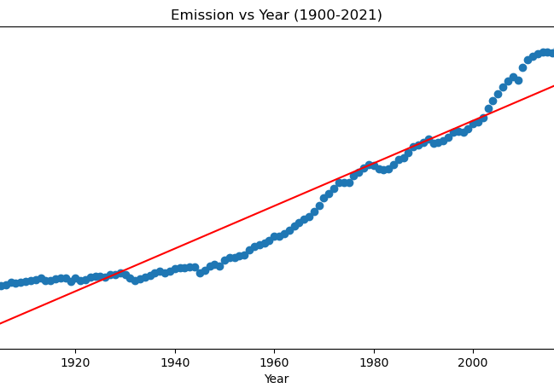
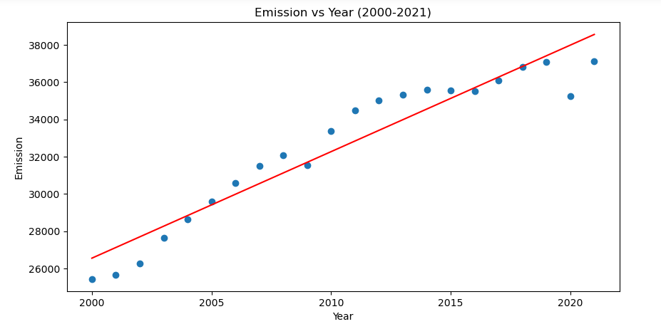
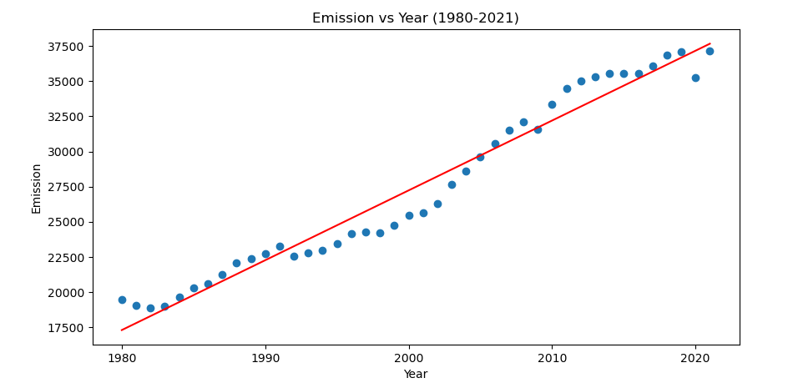
Timeframes Comparison
Exponential Regression Needed

Slide 11
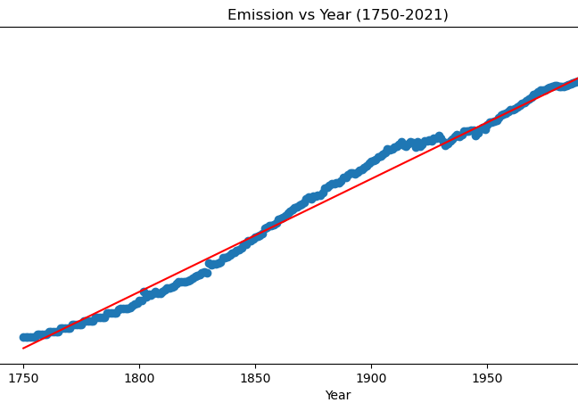
Timeframes Comparison
R2=0.987
R2=0.907
R2=0.914
R2=0.964

Slide 12
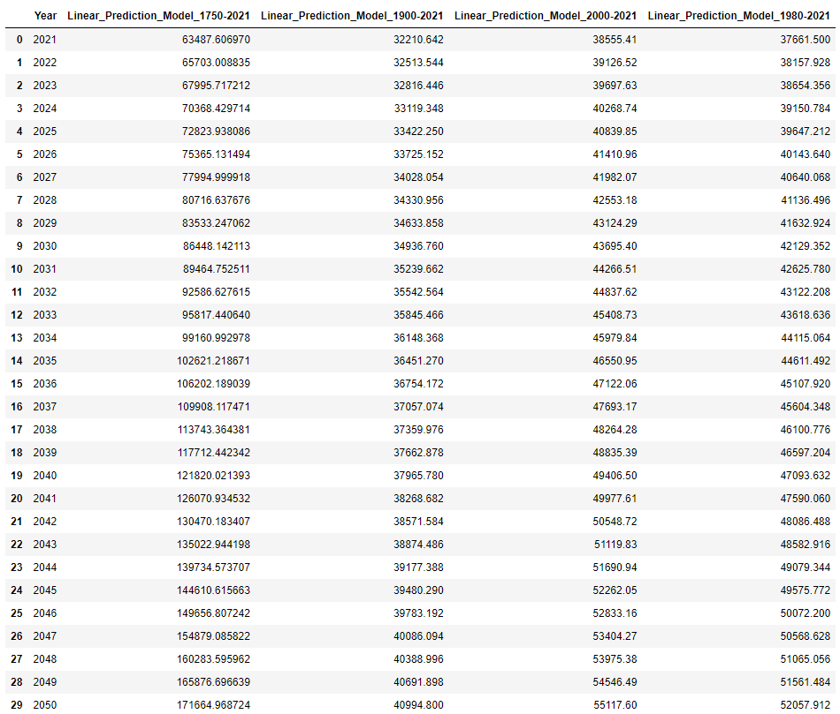










Prediction Model Results
Actual Emission in 2021 per our dataset : 37,123.85 million MtCO2
The 2000-2021 and 1980-2021 quite close in terms of predictions, signs of a constant growth rate for the last 40 years.

Slide 13
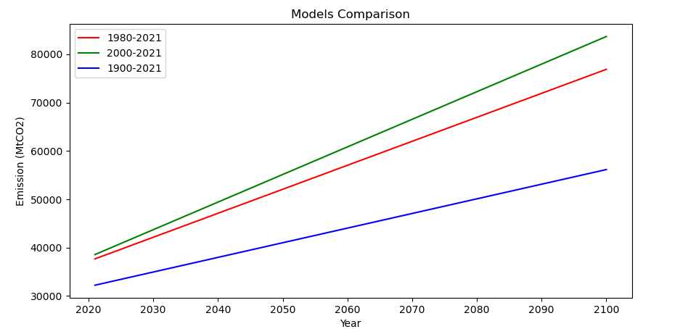
Model Comparison (Removing Exponential Outlier)
Since 1900 the emission growth rate has drastically increased. The predicted emission shifted upward over the years.
The graphs shows that the emission level does seems to want to plateau in term of growth rate.
All graphs shows that the CO2 level will keep increasing with the current global emission rate. This is true for all 3 predictions.
Hence, we will not meet the Paris Accord Goal of around ~16000 MtCO2 by 2030 (assuming same trend).

Slide 14
Unsupervised Machine Learning
The dataset provides detailed emissions level by country for over 200 years. This can give us an insight into how each country's emission level changes over the course of history.
By grouping countries together, we can identify large emitting countries quickly and target them to reduce emissions the most. For this task, we utilized unsupervised learning techniques, specifically K-means clustering. We focused on 1970, 2000, 2021.

Slide 15
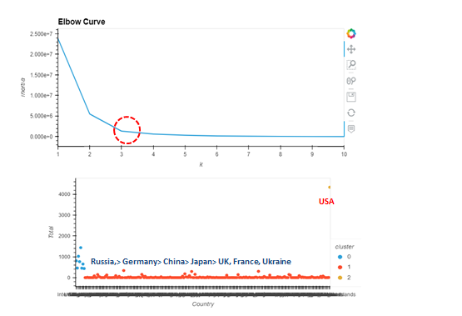
Unsupervised ML 1970

Slide 16
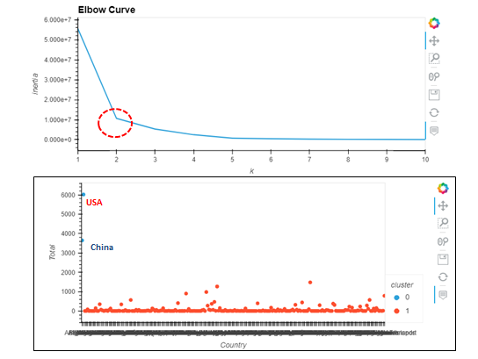
Unsupervised ML 2000

Slide 17
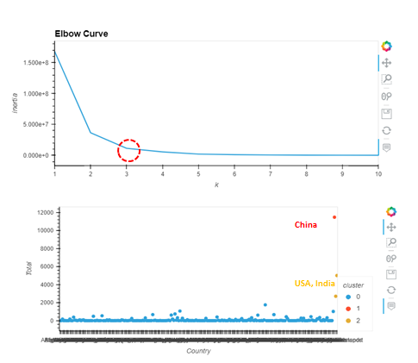
Unsupervised ML 2021

Slide 18
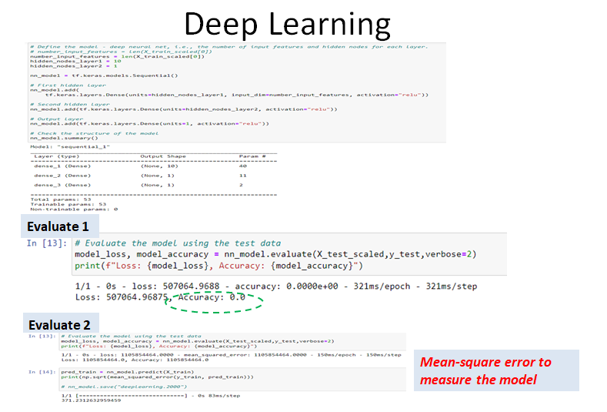
Deep Neural Network
Deep neural networks can learn from large sets of input data, regardless of data complexity. We wanted to explore deep neural networks to see if it's a good use case for our dataset as well.
Not a good fit because it does not work on continuous data

Slide 19
Data Visualization
Country emission by year
Country emission by trend (1750-2021)
Global Prediction

Slide 20
Conclusion
The Paris climate accord goal of CO2 emission by 2030 will not be reached (40% CO2 emission reduction rate compared to the 1990's level). Almost triple the target rate set for 2030 (~16000 MtCO2) based on current assumptions.
China (30.9%), USA (13.5%), India (7.3%) are the world biggest polluters. These 3 countries emitted more than 51.7% (19189 MtCO2) of all global CO2 in 2021.
Trend of how emitting countries change throughout history. Largest emitter in 1970 were the USA, as well as in 2000, and eventually they were surpassed by China in 2021, with India close behind.

